Slide 1
F-tests

Slide 2
Hypothesis Testing in Multiple Regression
Remember, multiple regression models the relationship between the dependent variable and multiple (k) explanatory variables, (x₁, x₂, . . . , x_{k}).
We want to know how to test the claim that a single variable (we’ll call x_{j}) or a group of variables (we’ll say x₁, x₂, . . , x_{j} ) are related to y.
We will use “j” to denote any of the k total explanatory variables.

Slide 3
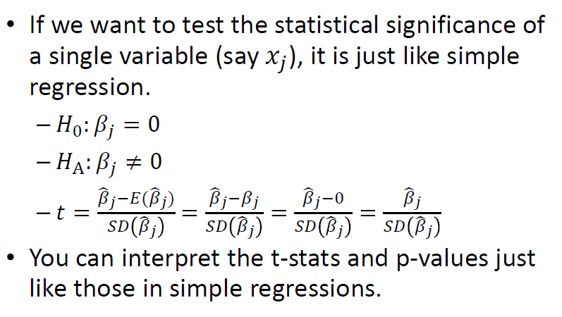
A single variable

Slide 4
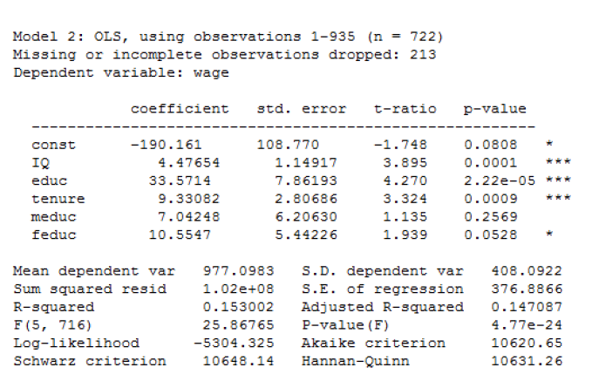

Slide 5
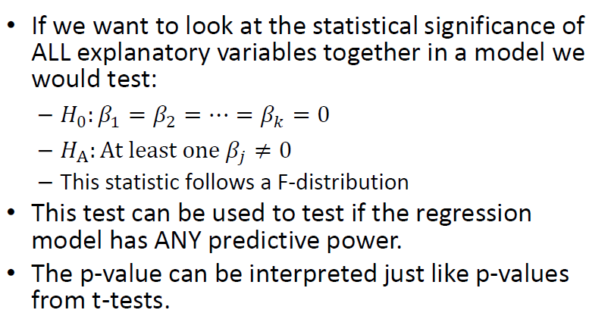
ALL explanatory variables

Slide 6
F-distribution
The F-distribution has two degrees of freedom: the numerator degrees of freedom (d₁) and the denominator degrees of freedom (d₂) . It is denoted F (d₁, d₂) .
The F-test for the overall significance of a multiple regression has the following distribution: F (k, n − k − 1) where n is the number of observations and k is the number of explanatory variables.

Slide 7
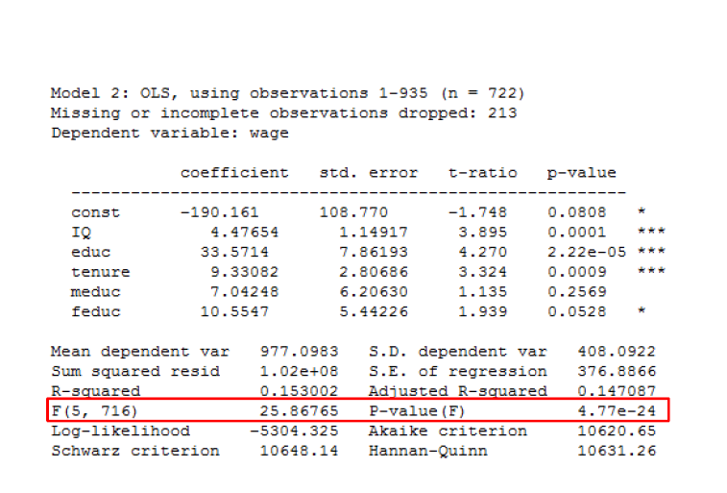

Slide 8
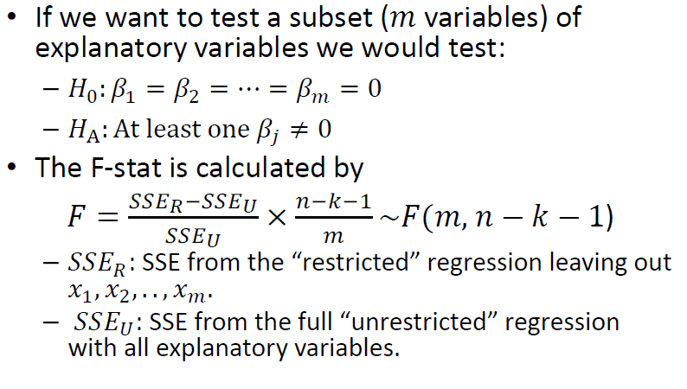
Testing a subset of variables (Partial F-test)

Slide 9
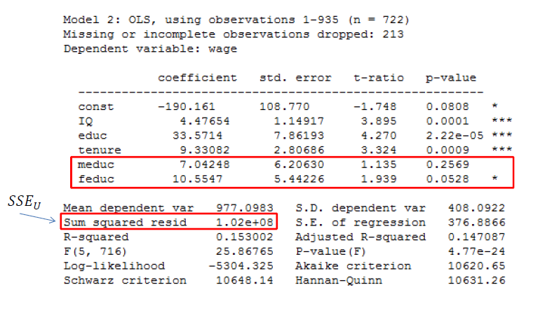
Example: Testing if Parent’s Education affect Children’s Income

Slide 10
